Slide 1


Phishing Detection Extension Proof of Concept

Slide 2


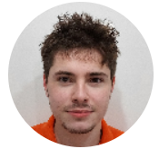
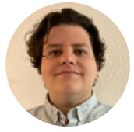
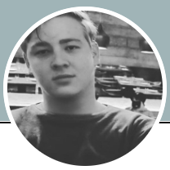
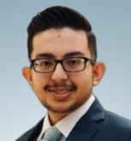
CIS – 4951 Capstone II
Senior Design Project
Ezekiel
Garcia
Jonathan
Iglesias
Professor: Dr. Sadjadi
Giovani
Labrador
Tristin
Liebenberg
Eyaan
Syed

Slide 3
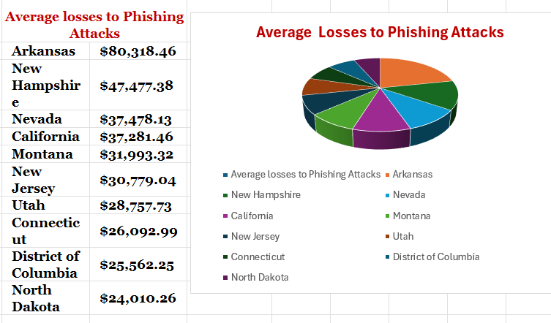
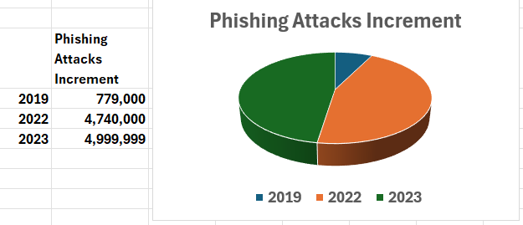
2019 to 2023
541.93%

Slide 4

Steps to cover & Methodology / System used
Description of the issue
Characteristics
Goals & Objectives
Scope & Limitations
Key functionalities & features
Component overview
Overall System Architecture
Setting & Development
Key Java Libraries & Tools
Suspicious Content Detection
User Alerts & Notifications

